Slide 1


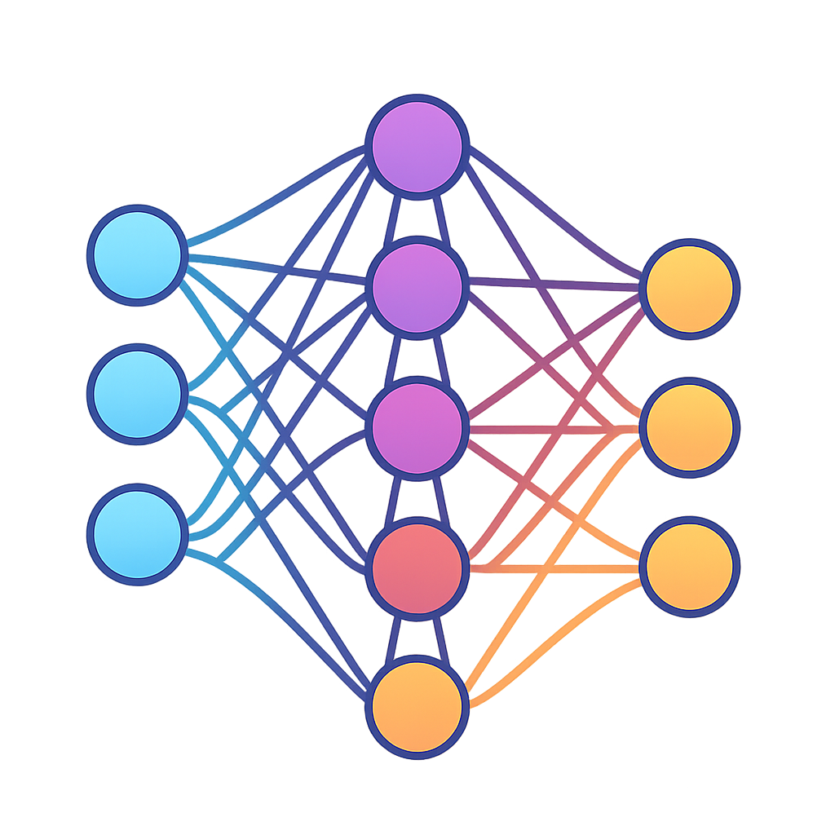
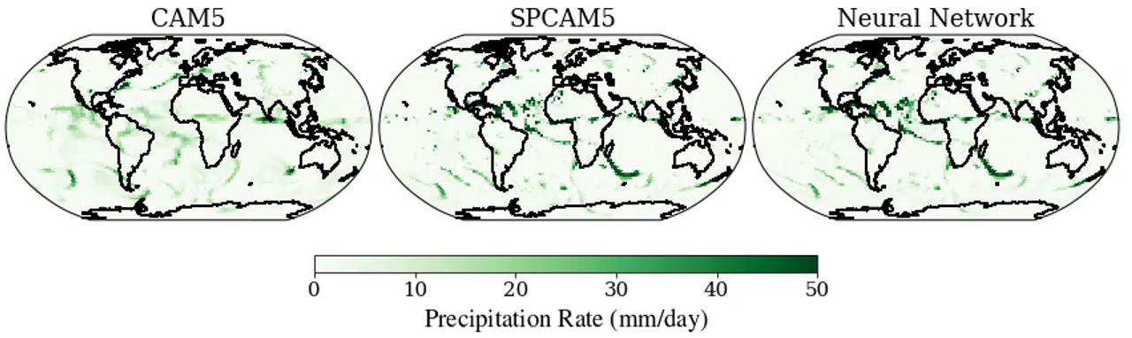
ML for Earth & Env Sci (Week 4, SA2025)
Traditional Model (too smooth!)
High-fidelity model (too expensive!)
Neural Network
Precipitation rate (mm/day)
How can we emulate complex, nonlinear, high-dimensional environmental processes with machine learning?
Source: Mooers et al. (2021)
Notes:
CAM runs in a couple of hours on a couple of cores; SPCAM takes days on thousands of computer cores. The neural network on the right makes it 10x less expensive.

Slide 2
Min 15-50: Neural Networks for High-Dimensional, Nonlinear Processes
Learning Objectives (Géron Ch10 & Ch11):
Define an artificial neural network
Understand the steps & best practices to build an artificial neural network
Understand activation functions
Know the main hyperparameters defining a neural network’s architecture
Know the main hyperparameters controlling the training of a neural network

Slide 3
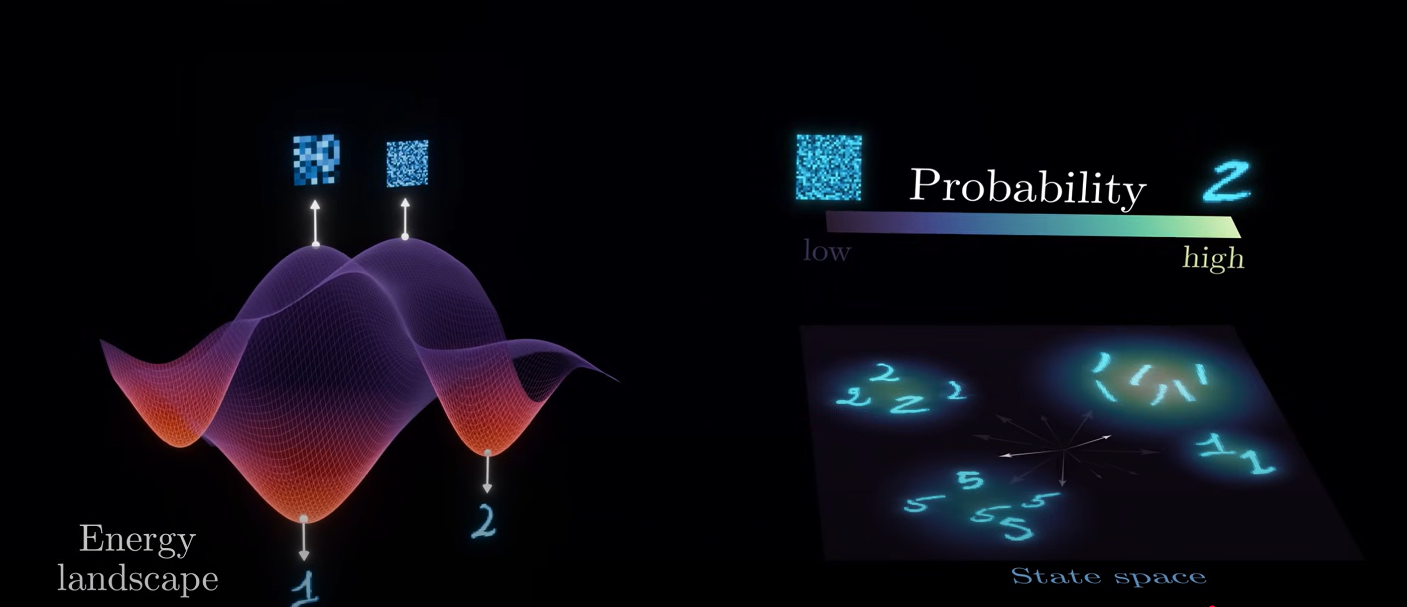
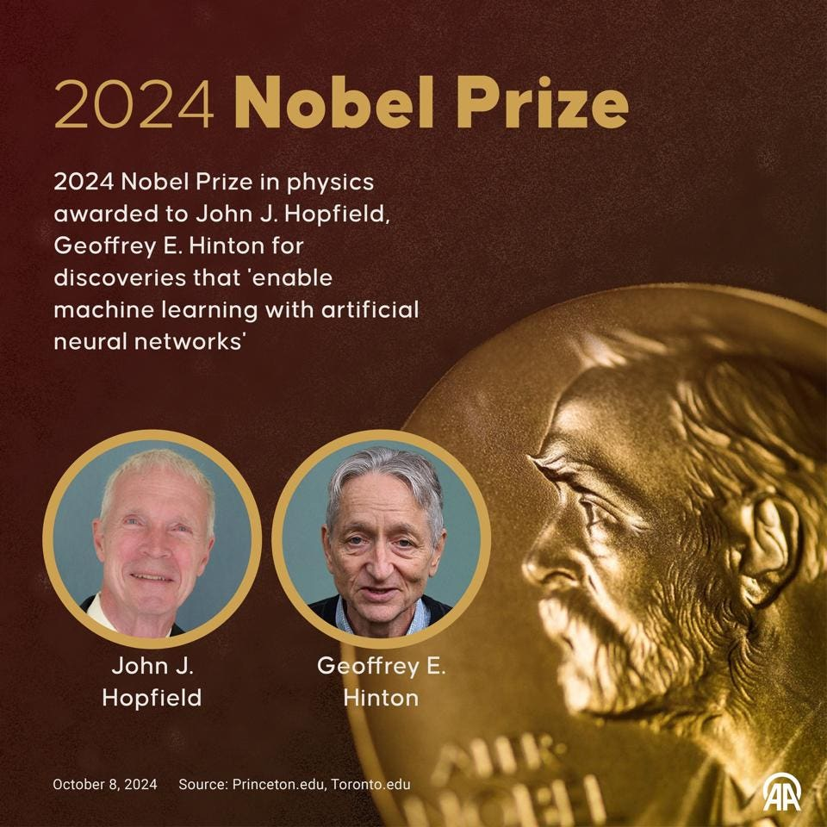
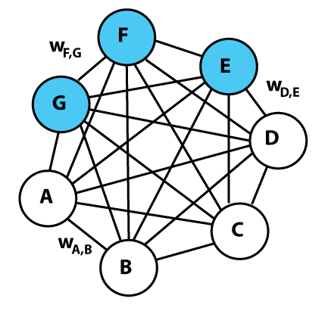
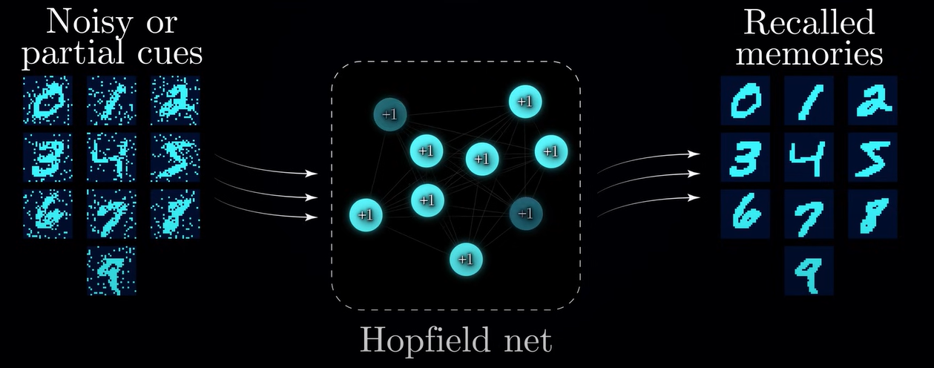
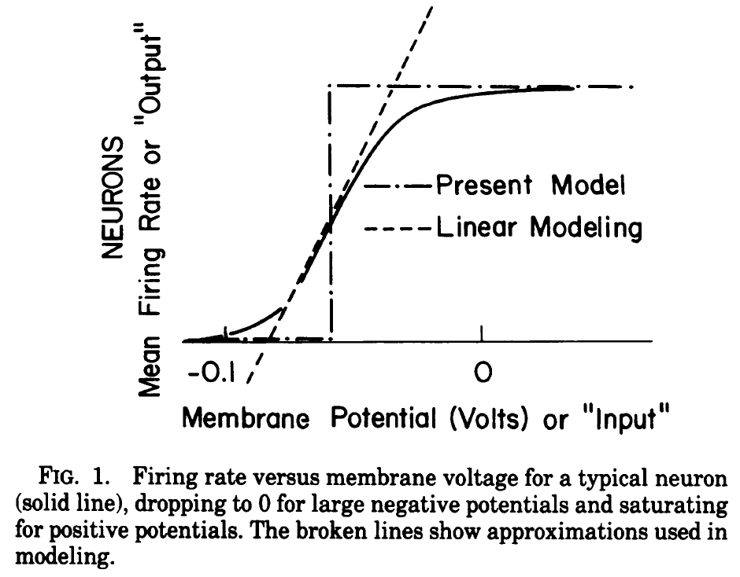
Sources: Forbes, Wikipedia, Hopfield (1982), Artem Kirsanov
Boltzmann machine (1983-1985)
Hopfield network (1982)
Notes:
“for foundational discoveries and inventions that enable machine learningwith artificial neural networks” Hopfield network = recurrent neural network that can store and recall patterns

Slide 4
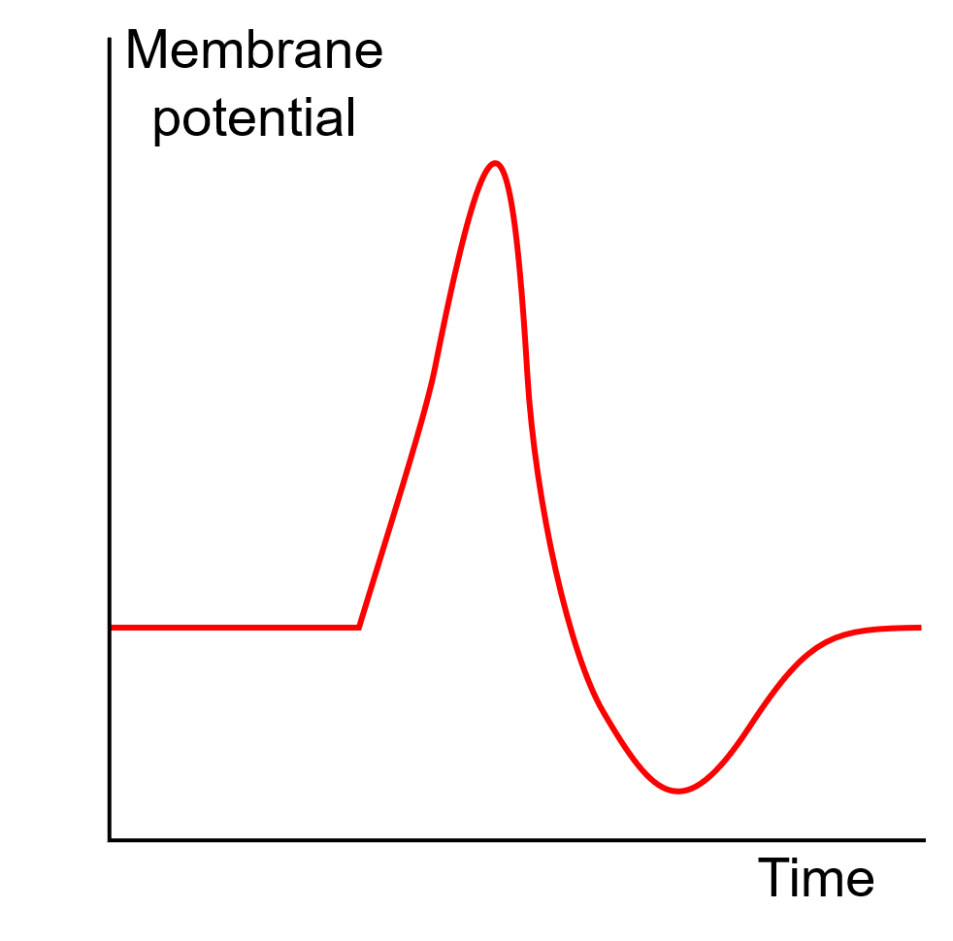
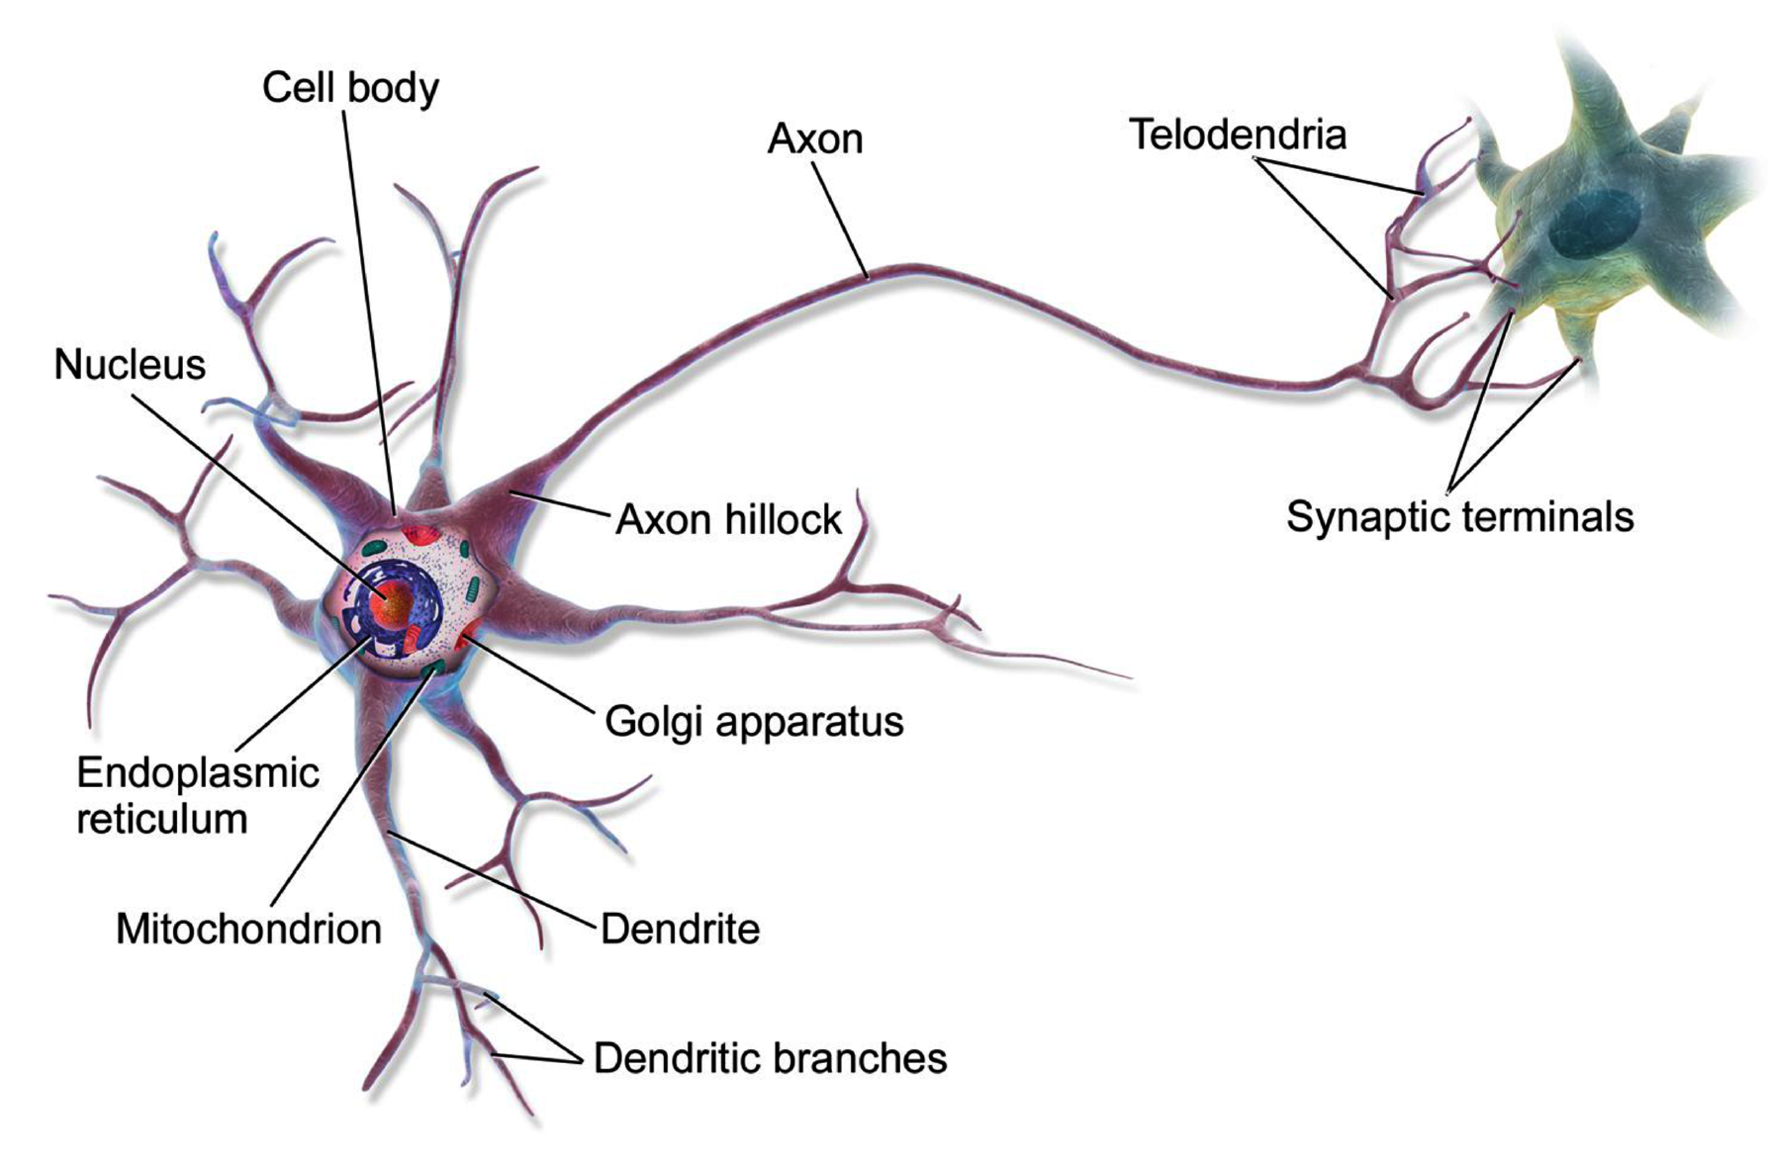
From biological to artificial neural networks
Action Potential
Source: Wikimedia Commons
Notes:
Biological neurons produce short
electrical impulses called action potentials (APs, or just signals), which travel along
the axons and make the synapses release chemical signals called neurotransmitters.
When a neuron receives a sufficient amount of these neurotransmitters within a
few milliseconds, it fires its own electrical impulses

Slide 5
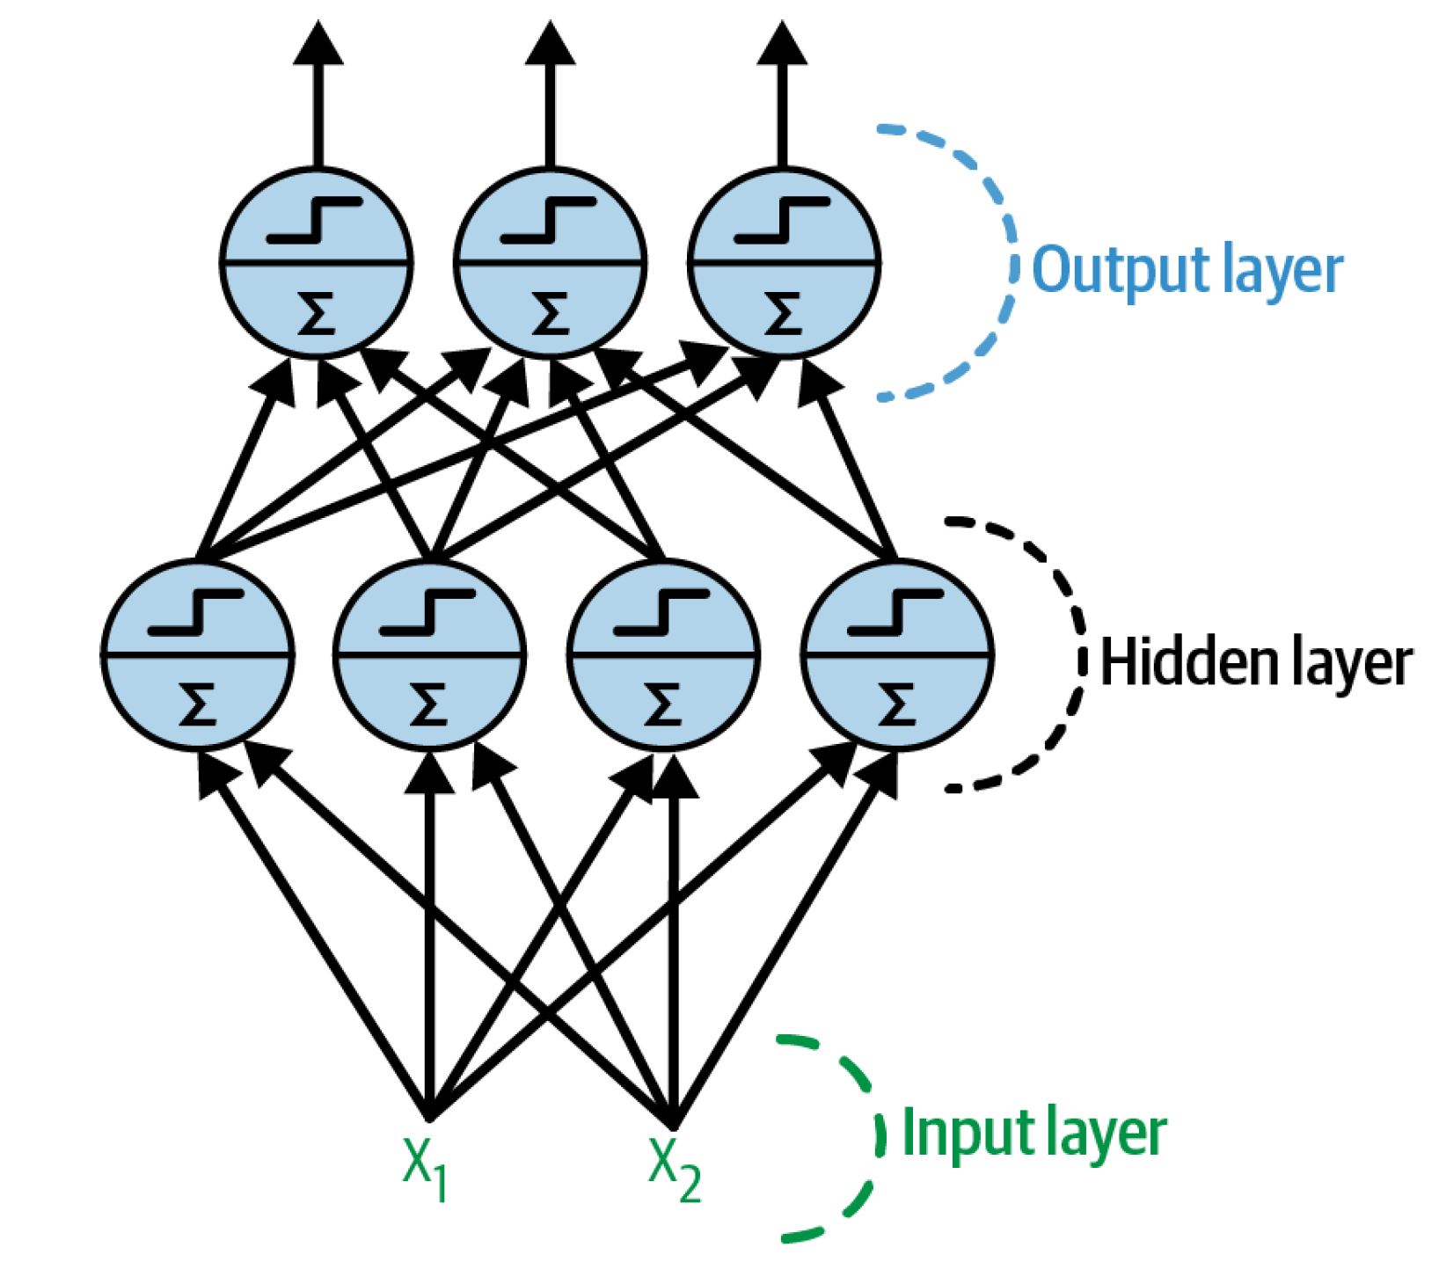
From biological to artificial neural networks
Action Potential
Source: Wikimedia Commons, Géron (Ch. 10)
Notes:
Biological neurons produce short electrical impulses called action potentials (APs, or just signals), which travel along the axons and make the synapses release chemical signals called neurotransmitters. When a neuron receives a sufficient amount of these neurotransmitters within a few milliseconds, it fires its own electrical impulses

Slide 6
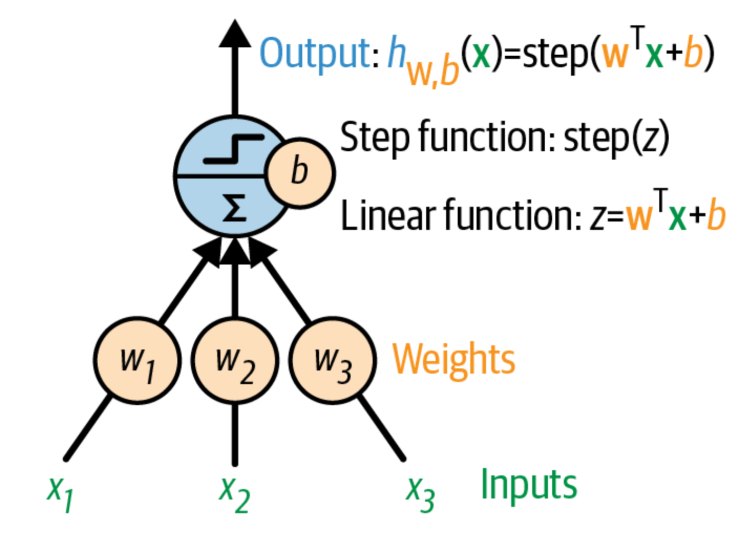
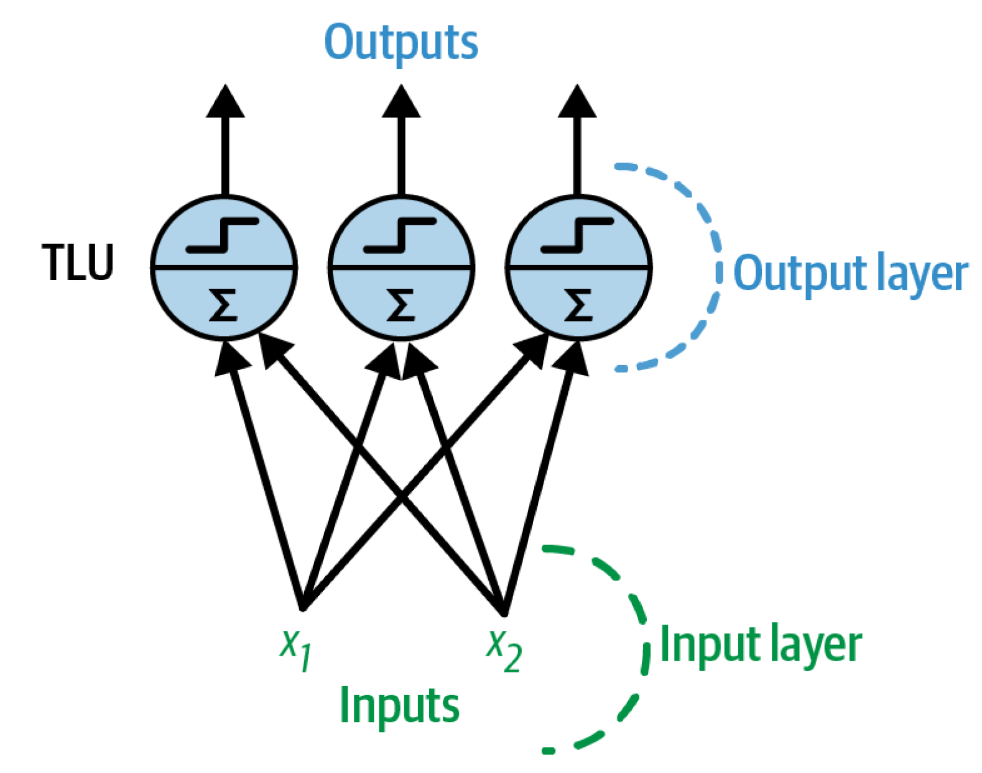
From the perceptron to a fully connected layer
3 inputs, 1 output
2 inputs, 3 outputs
Notes:
TLU = Threshold logic unit

Slide 7


From the perceptron to a fully connected layer
Input Vector
Weight Matrix
Activation Function
Bias Vector (Intercept)
2 inputs, 3 outputs

Slide 8

From fully connected layer to Multilayer Perceptron
Notes:
1 layer = similar to logistic regression
2 layers = shallow neural network
Deep learning = 3 layers and above

Slide 9
Feedforward neural net

Slide 10
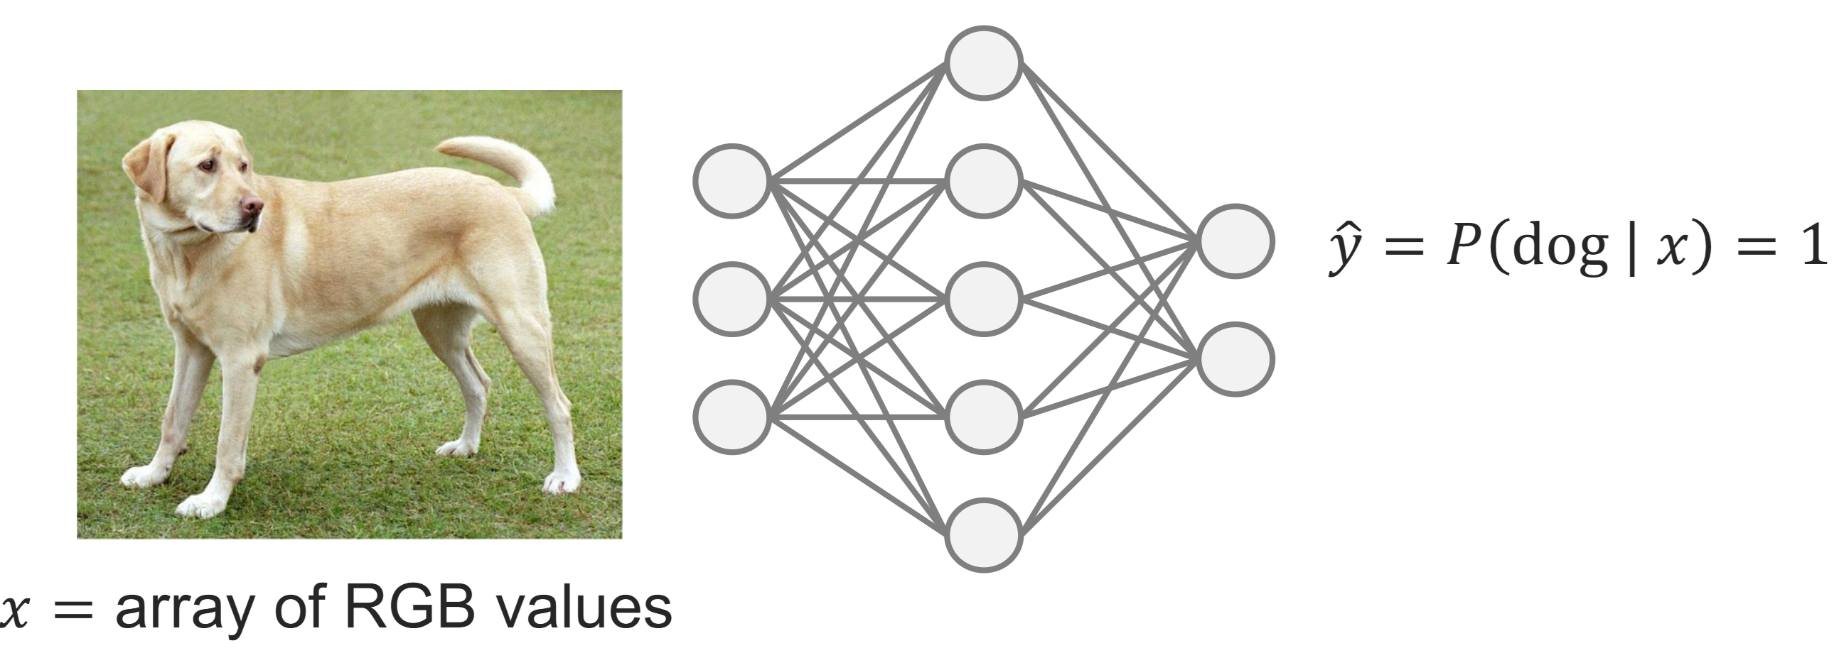
Universal Approximation Theorem: By making an artificial neural network wide enough (large W) or by making an artificial neural network deep enough (many combined ϕ) A neural network can represent any continuous functions
Sources: Cybenko & Hornik (1989), Leshno et al. (1993), Zhou et al. (2017)
Image source: ETHZ Deep Learning for scientific comp.
Notes:
And this is what makes deep learning so successful: Works best in the large data regime Question 1: Can you think of an example where this useful?

Slide 11
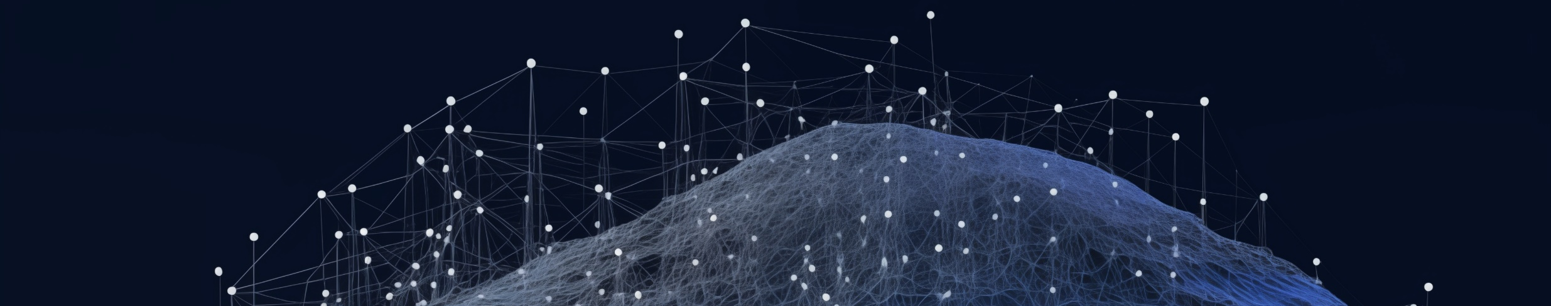
Universal Approximation Theorem: By making an artificial neural network wide enough (large W) or by making an artificial neural network deep enough (many ϕ) A neural network can represent any continuous functions
and even any nonlinear continuous operator
Source: Lu et al. (2021) Image source: Midjourney

Slide 12
?
?
?
?
How to train so many weights and biases?

Slide 13




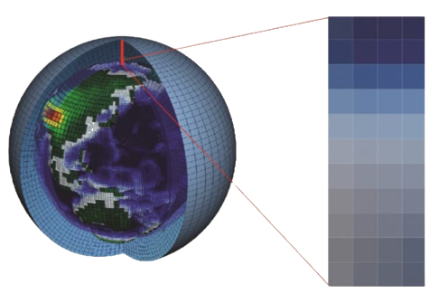
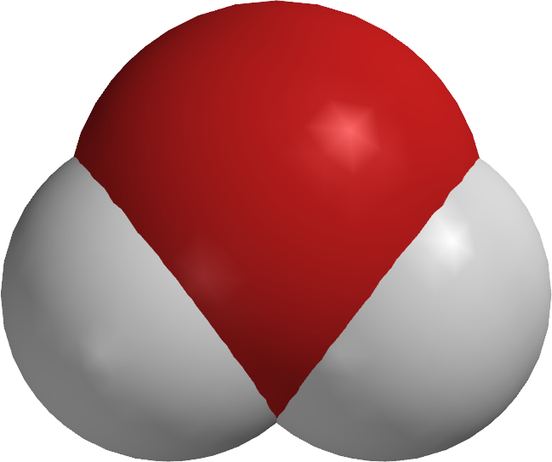
☹️

Slide 14

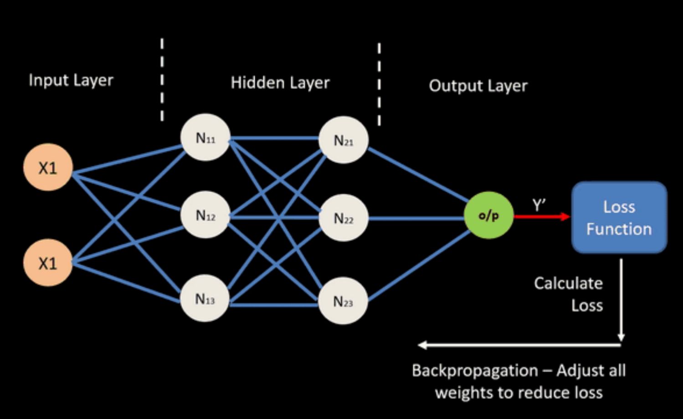

Automatic differentiation:
🙂‍↔️
Notes:
Vanishing gradient = Graident

Slide 15
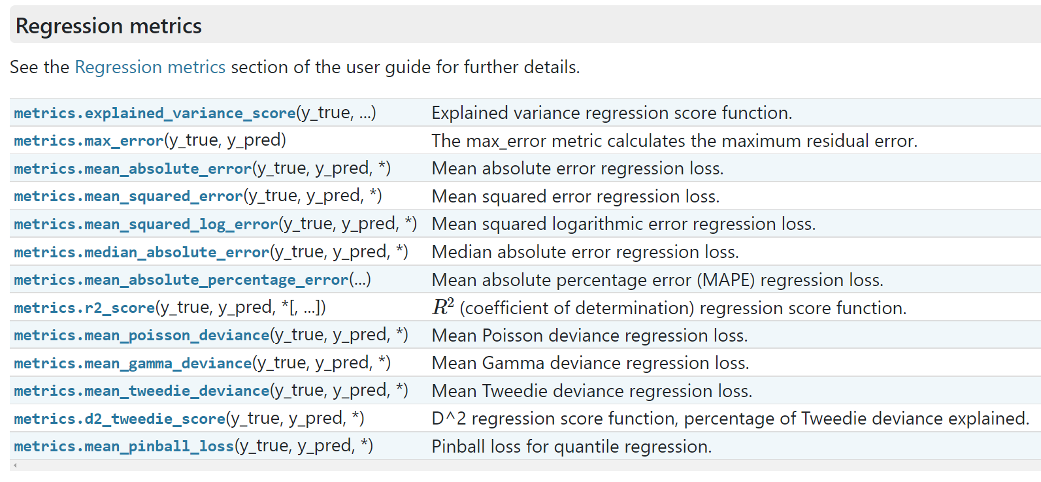
How to build a neural network in practice?
Define your problem (classification versus regression, loss function)

Slide 16
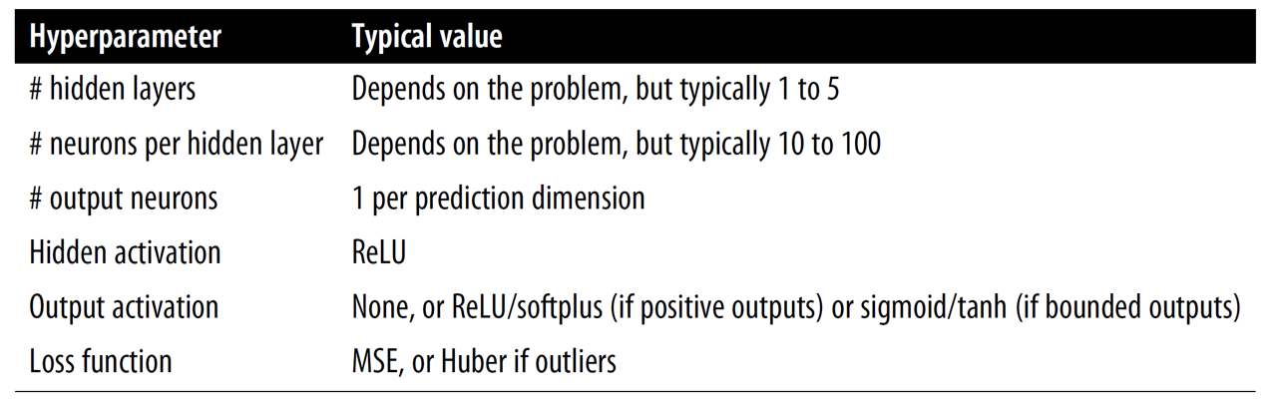
How to build a neural network in practice?
Define your problem (classification versus regression, loss function)
Pre-process the data (training/validation/test split, normalization/scaling)
Choose your architecture:

Slide 17
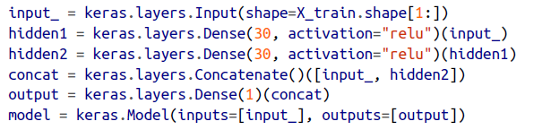

How to build a neural network in practice?
Define your problem (classification versus regression, loss function)
Pre-process the data (training/validation/test split, normalization/scaling)
Choose your architecture & implement it using sequential/functional API
Sequential API
Functional API
model = keras.models. Sequential([ … ])

Slide 18
How to build a neural network in practice?
Define your problem (classification versus regression, loss function)
Pre-process the data (training/validation/test split, normalization/scaling)
Choose your architecture & implement it using sequential/functional API
Choose your training hyperparameters (layer width, # of layers, etc.)
Train your neural network on the training set
Use the validation set to optimize hyperparameters & for callbacks

Slide 19
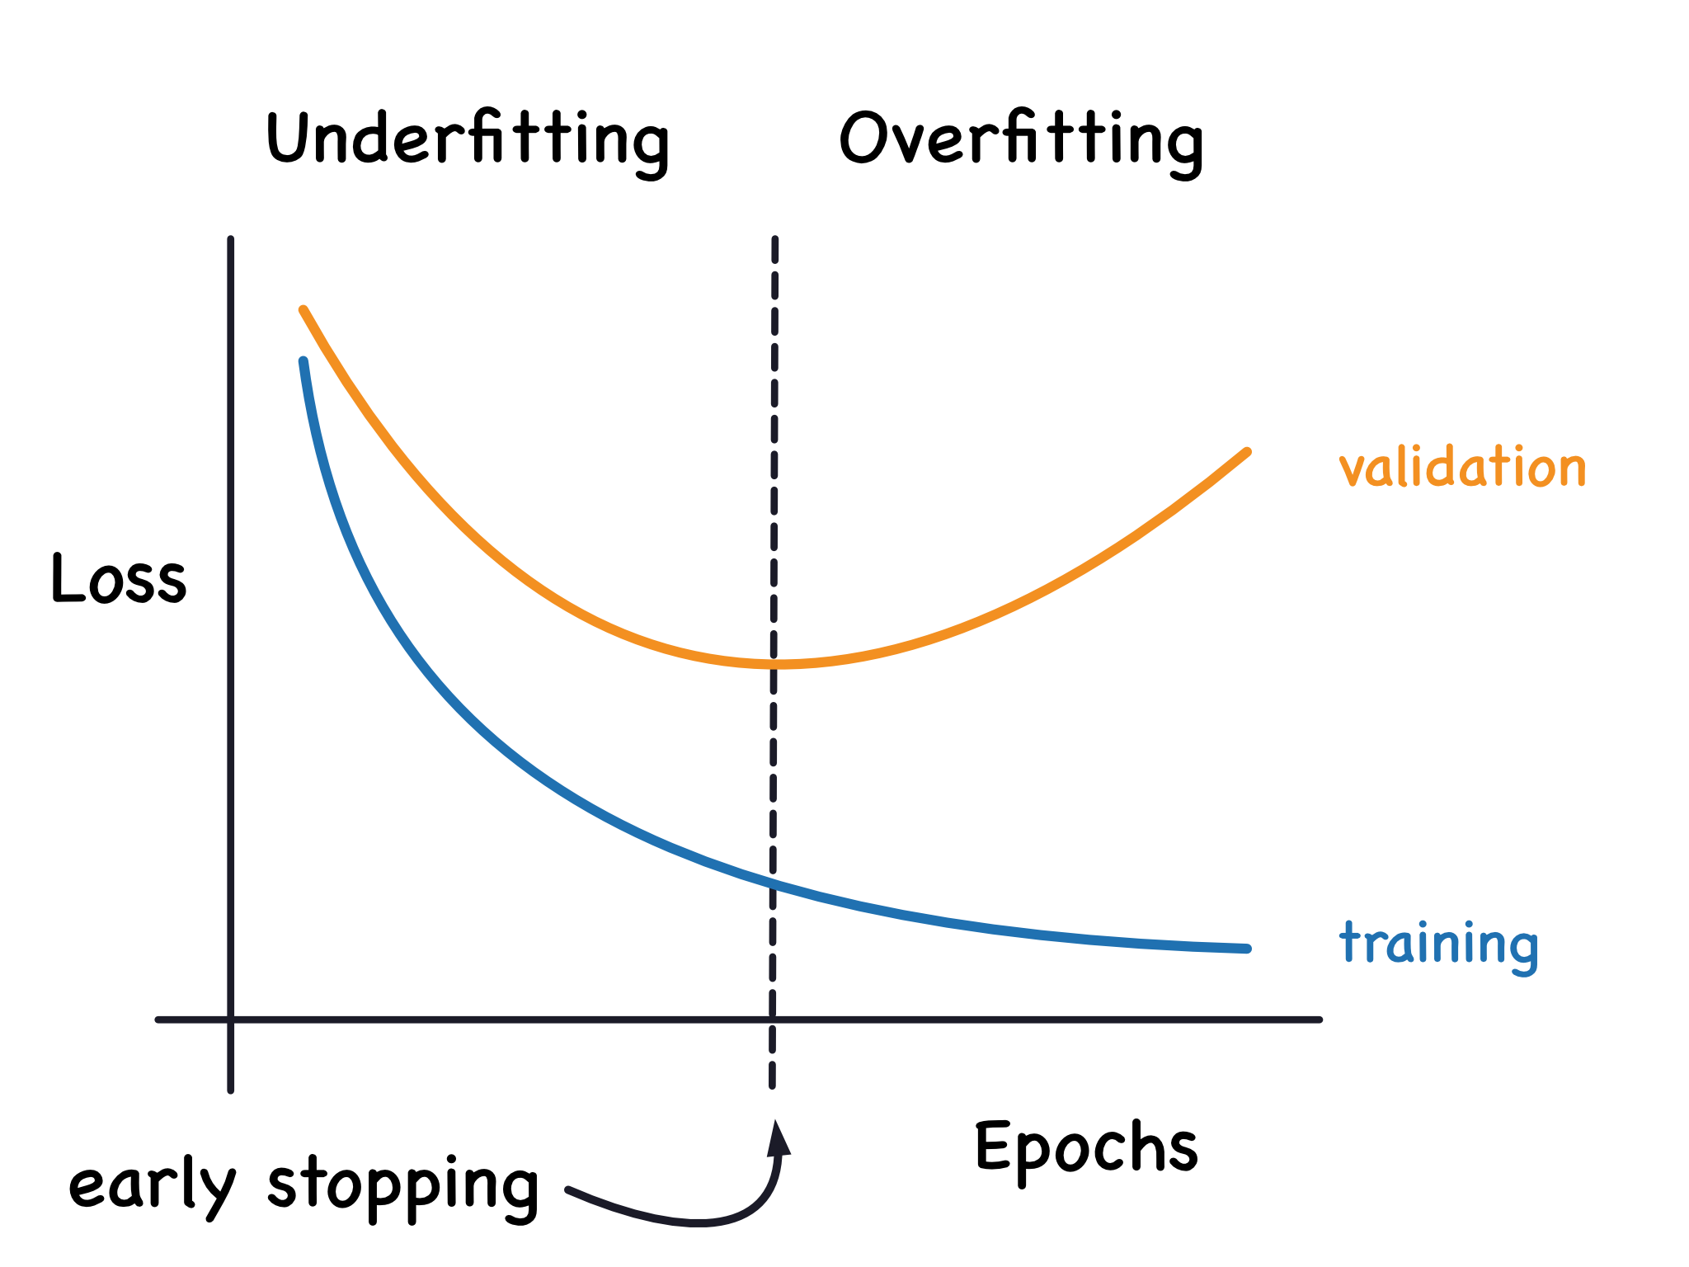
How to build a neural network in practice?
Define your problem (classification versus regression, loss function)
Pre-process the data (training/validation/test split, normalization/scaling)
Choose your architecture & implement it using sequential/functional API
Choose your training hyperparameters (learning rate, batch size)
Train your neural network on the training set
Use the validation set to optimize hyperparameters & for callbacks
(callback)
#Epoch = Going through the entire training set once
Source: Kaggle
Notes:
Question: Where would you stop the training?

Slide 20
How to build a neural network in practice?
🍽️
🍽️
Define your problem (classification versus regression, loss function)
Pre-process the data (training/validation/test split, normalization/scaling)
Choose your architecture & implement it using sequential/functional API
Choose your training hyperparameters (learning rate, batch size, etc.)
Train your neural network on the training set
Use the validation set to optimize hyperparameters & for callbacks (Hyperparameter optimization libraries = Hyperopt, Optuna, Keras Tuner)
Your network is ready ☺ Evaluate it on the test set and you’re done!

Slide 21
Neural Networks for High-Dimensional, Nonlinear Processes
Learning Objectives (Géron Ch10 & Ch11):
Define an artificial neural network
Understand the steps & best practices to build an artificial neural network
Understand activation functions
Know the main hyperparameters defining a neural network’s architecture
Know the main hyperparameters controlling the training of a neural network

Slide 22
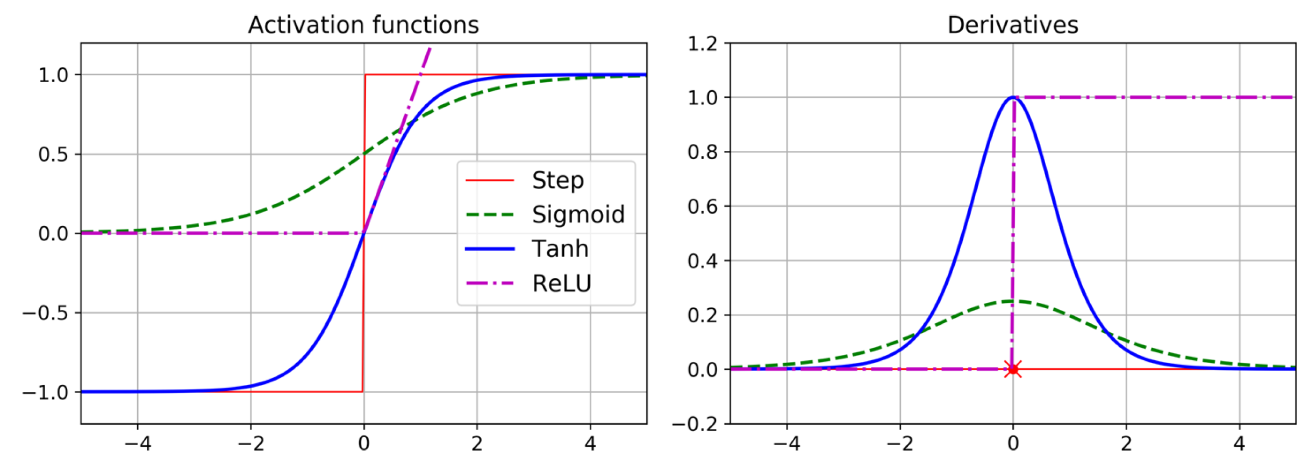

Slide 23
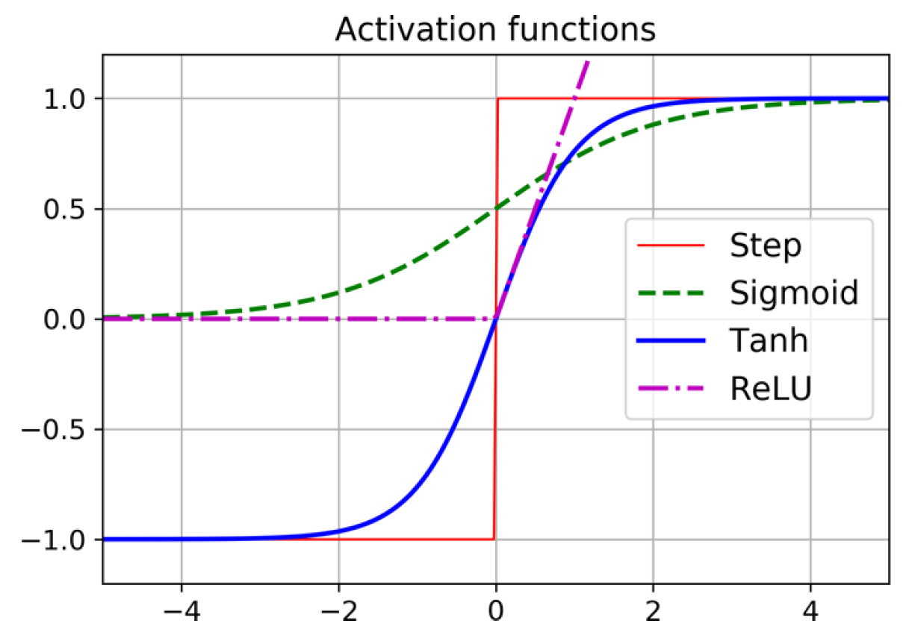
Choose activation function: Tanh > Sigmoid (Logistic)
Source: Géron (Ch. 10)

Slide 24
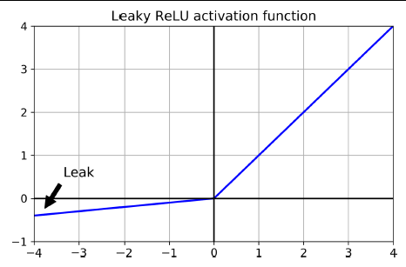
Choose activation function: Leaky ReLU > ReLU > Tanh > Sigmoid
Source: Géron (Ch. 10)

Slide 25
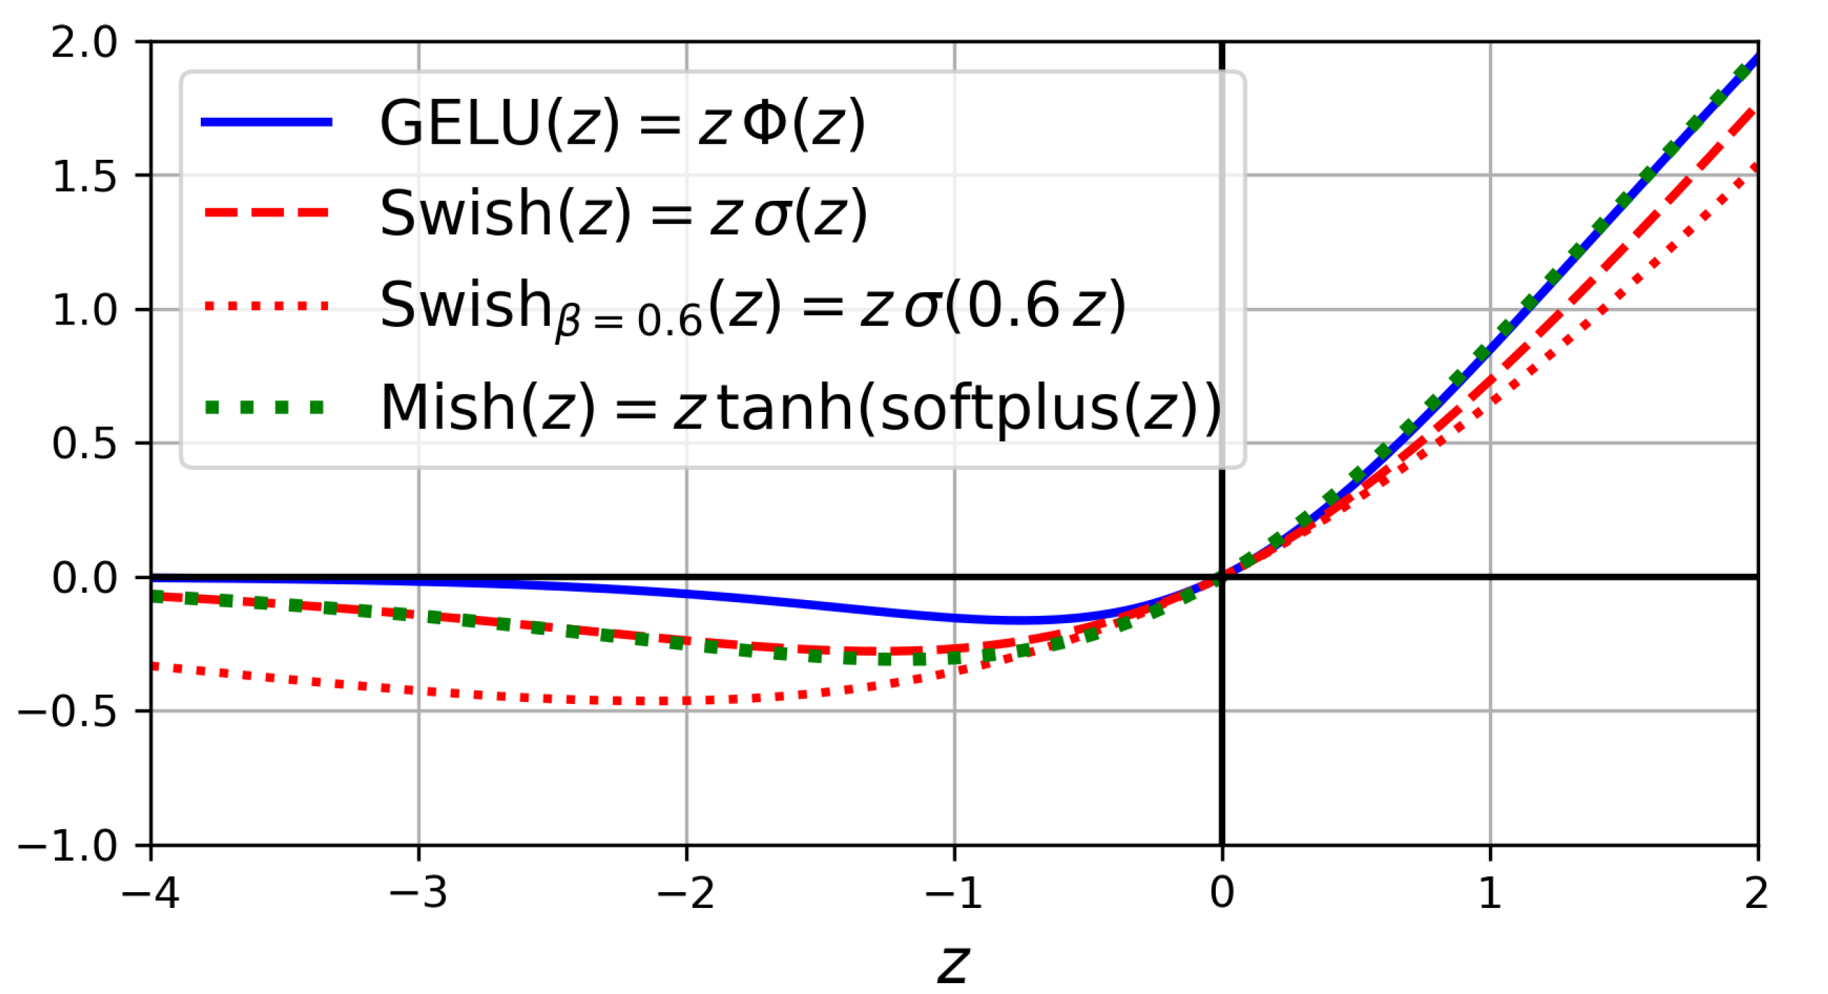
Choose activation function: Swish > SELU > Leaky ReLU > ReLU > Tanh > Sigmoid
Source: Géron (Ch. 10)
Notes:
Question 2: To predict an environmental variable, e.g., a flux, that’s always between -1 and 1, which activation function(s) would you choose?

Slide 26
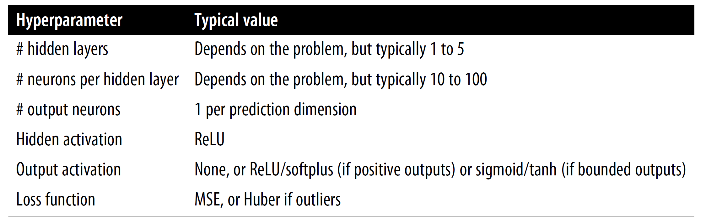
Hyperparameters related to the architecture
Source: Géron (Ch. 10)

Slide 27

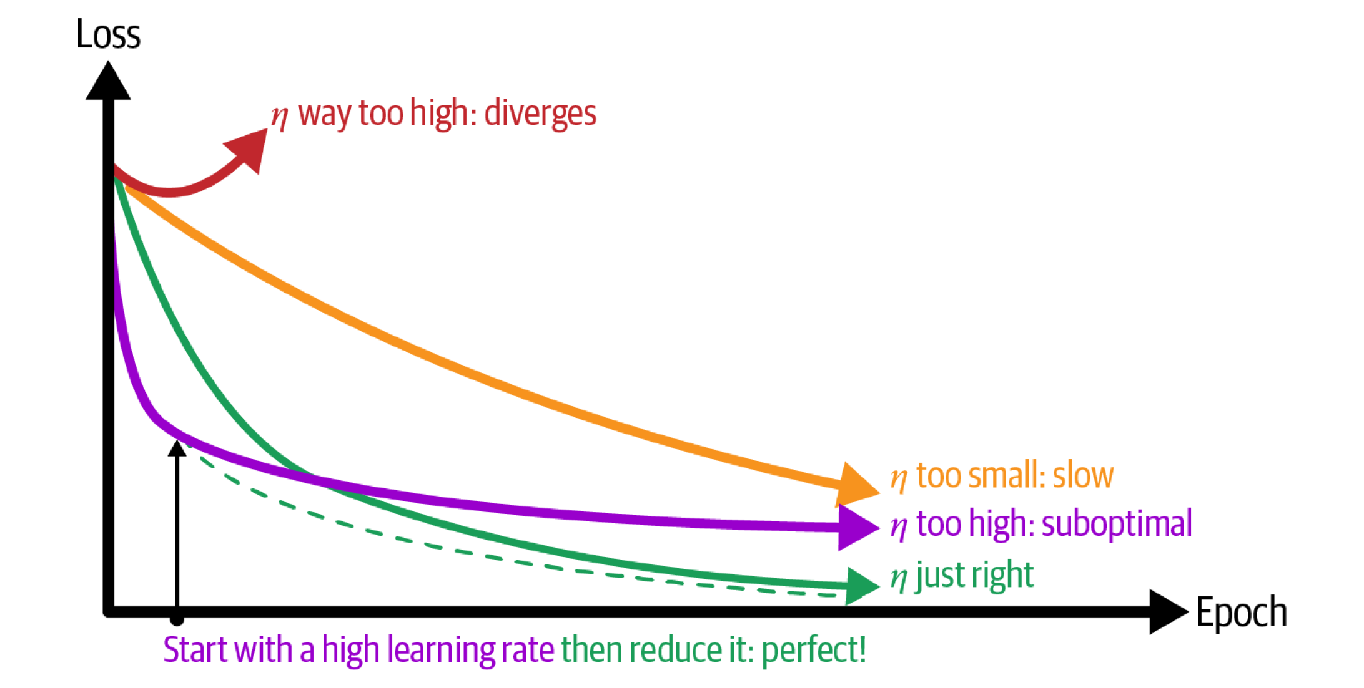
Hyperparameters related to the training
Loss function:
MSE, MAE, Huber for regression
Cross-entropy for classification
Batch size, Initialization of weights
Optimizer
Learning Rate
Source: towardsdatascience.com
Notes:
Question 3: Which optimizer would *you* choose?

Slide 28
Overfitting? Regularize ☺
L1/L2 regularization: Loss += |Weights,Biases| + (Weights,Biases)²
Batch normalization: Automatically scale inputs using (mean , standard deviation) calculated over the batch

Slide 29
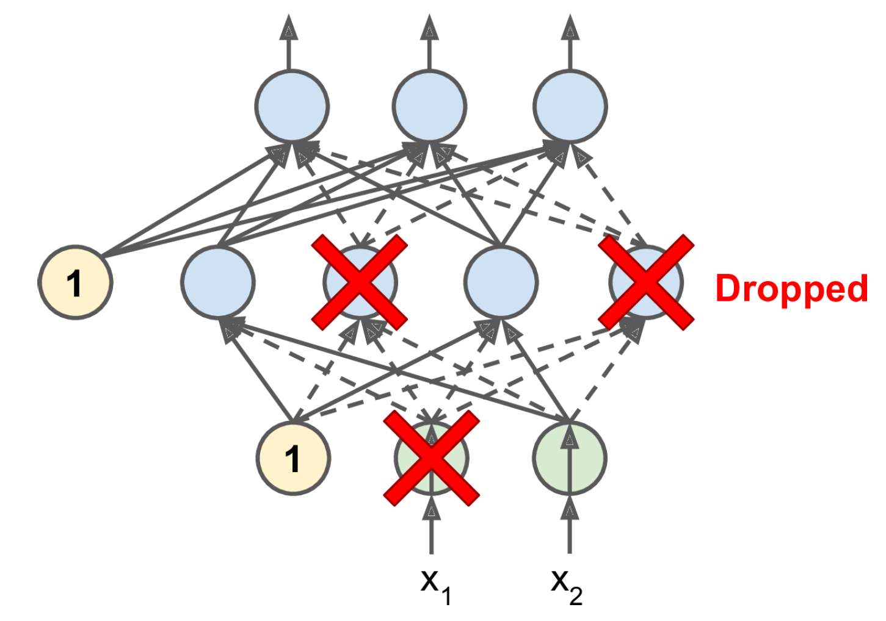
Overfitting? Regularize ☺
L1/L2 regularization: Loss += |Weights,Biases| + (Weights,Biases)²
Batch normalization: Automatically scale inputs using (mean , standard deviation) calculated over the batch
Dropout (can add uncertainty)

Slide 30



Min 50-60: Moodle Quiz & Feedback ↓ Moodle Quiz | Feedback ↓

Slide 31

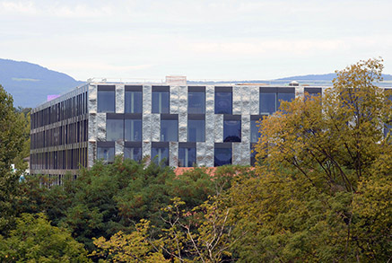
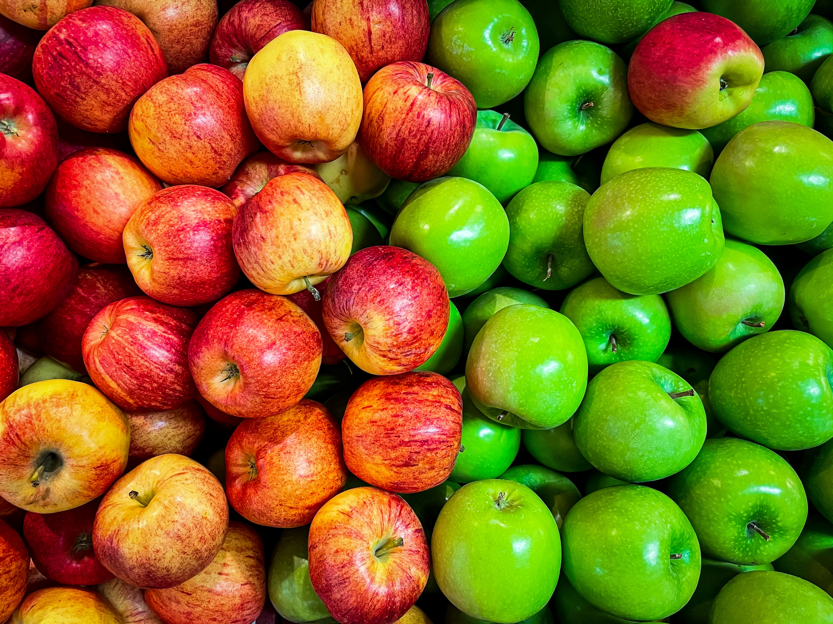
Min 60-75: Break

Slide 32
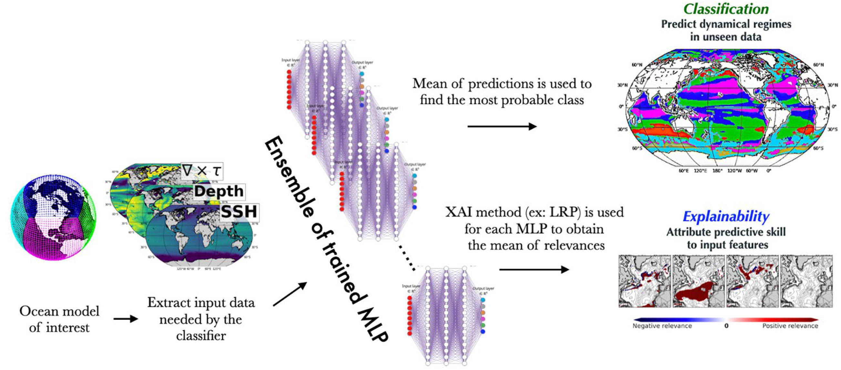
Min 75-110: Unsupervised Learning to Elucidate Environmental Complexity

Slide 33
Legacy

Slide 34
Adjusting the weights requires calculating the gradient of the loss
To calculate gradients, neural networks use automatic differentiation
Notes:
Vanishing gradient = Graident

Slide 35

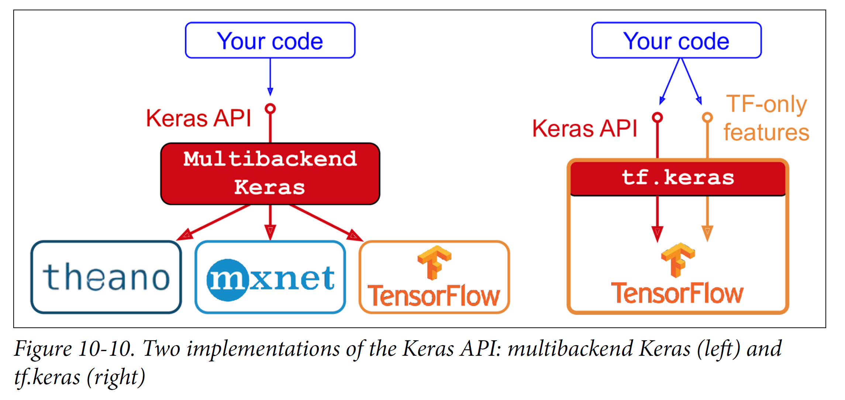
API = Application Programming Interface = Way for computer programs to communicate
≠ GUI
(Graphical User
Interface)
≠ IDE
(Integrated Development Environment)
Source: Géron
Notes:
Not ton confuse with a GUI, or Graphical User Interface, is a visual interface that allows users to interact with and control computer software through graphical elements such as windows, icons, buttons, and menus, making it easier for users to perform tasks and access features.
Integrated Development Environment (IDE) is a software application that combines various tools essential for software development into a single interface.

Slide 37
Can we learn How the Oceanic Circulation will Change with Climate from Data?
Problem: - The full-complexity/depth ocean models are only reliable in the present
- Climate models used to predict the future only have a few reliable labels
Idea: Train a classifier to detect dominant circulation regime from labels
Result: Prediction of complex circulation changes with climate

Slide 38
Min 15-30: Moodle Quiz (7 questions, 25 min)
Learning Objectives (Moodle Quiz at Min 45 on Géron Ch8+9):
Understand the necessity of reducing dimensionality for big datasets
Know at least two approaches for dimensionality reduction
Understand the steps of Principal Component Analysis
Distinguish clustering from supervised classification
Know how to implement the K-means algorithm and select the number of clusters
Know how to implement Gaussian mixture models and how to detect anomalies
Notes:
Questions?
Not graded

Slide 39
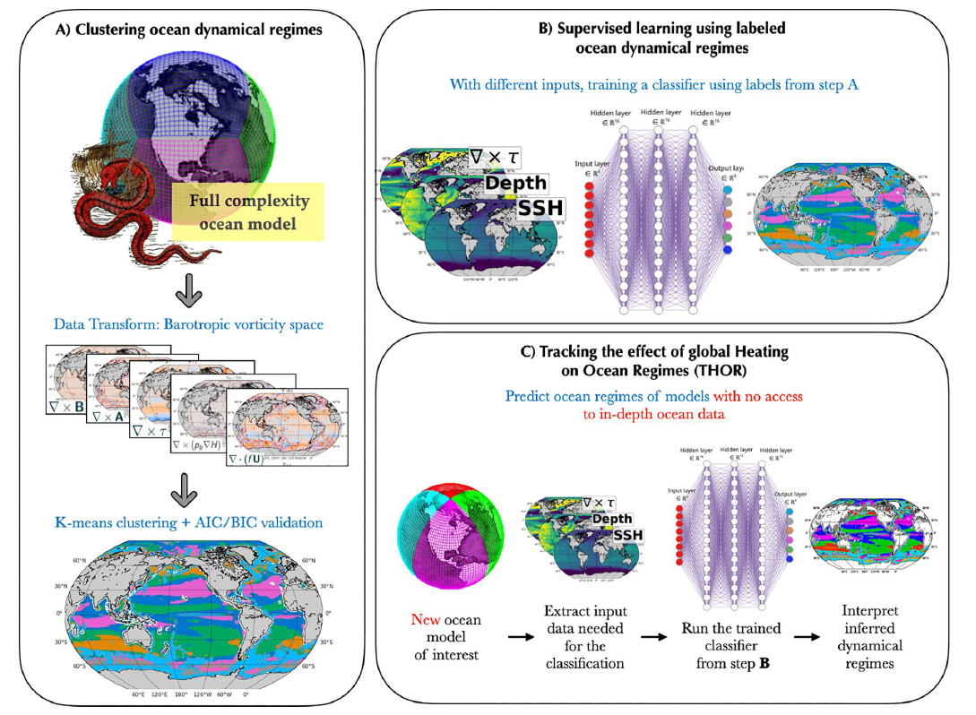
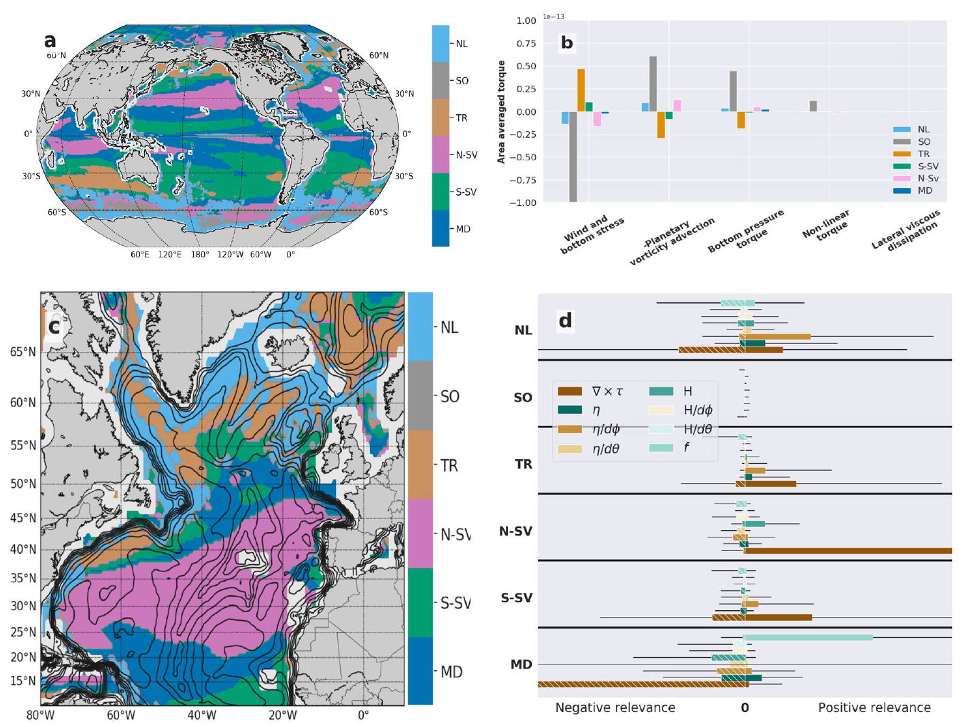

Slide 40
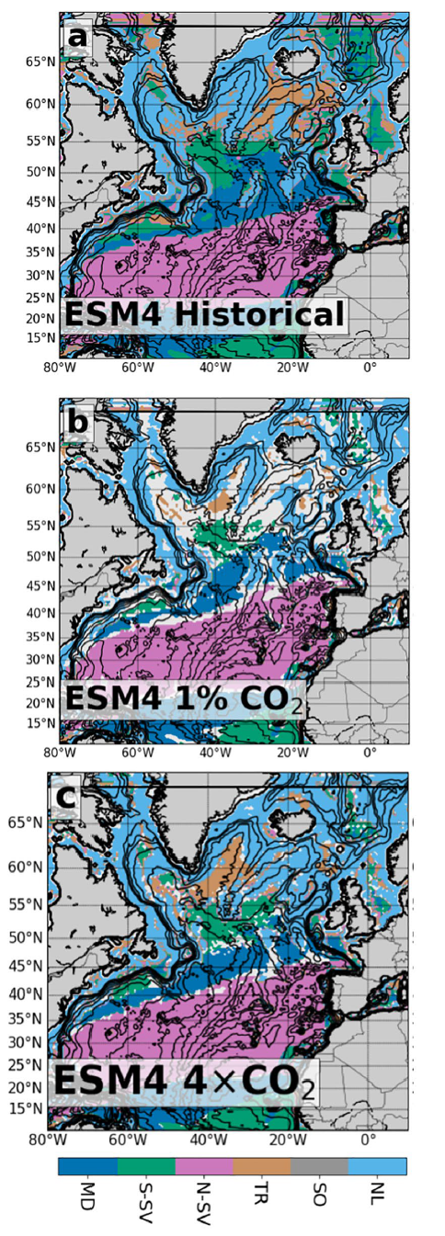
How is this dynamical regime expected to change in response to an increase in the atmospheric carbon dioxide concentration? Why?

Slide 41
What is a dynamical regime?
Dynamical regime: regions with similar drivers governing circulation
A dynamical regime is a climatic regime driven by dynamical terms such as (a) the wind and bottom stress curl, (b) the advection of planetary vorticity, (c) bathymetric interactions through bottom pressure torque (BPT), (d) curl of nonlinear interactions between terms and (e) lateral viscous dissipation from within the ocean interior.

Slide 42
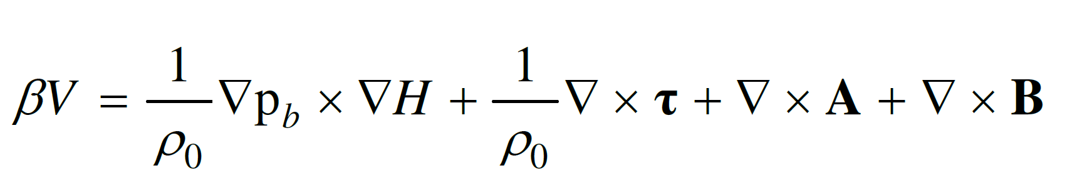
Bottom Pressure Forces
Small-scale eddies
North-South Circulation
Surface Wind Stress
Viscous Dissipation

Slide 43
Let’s pick a regime!
(Hand vote)

Slide 44
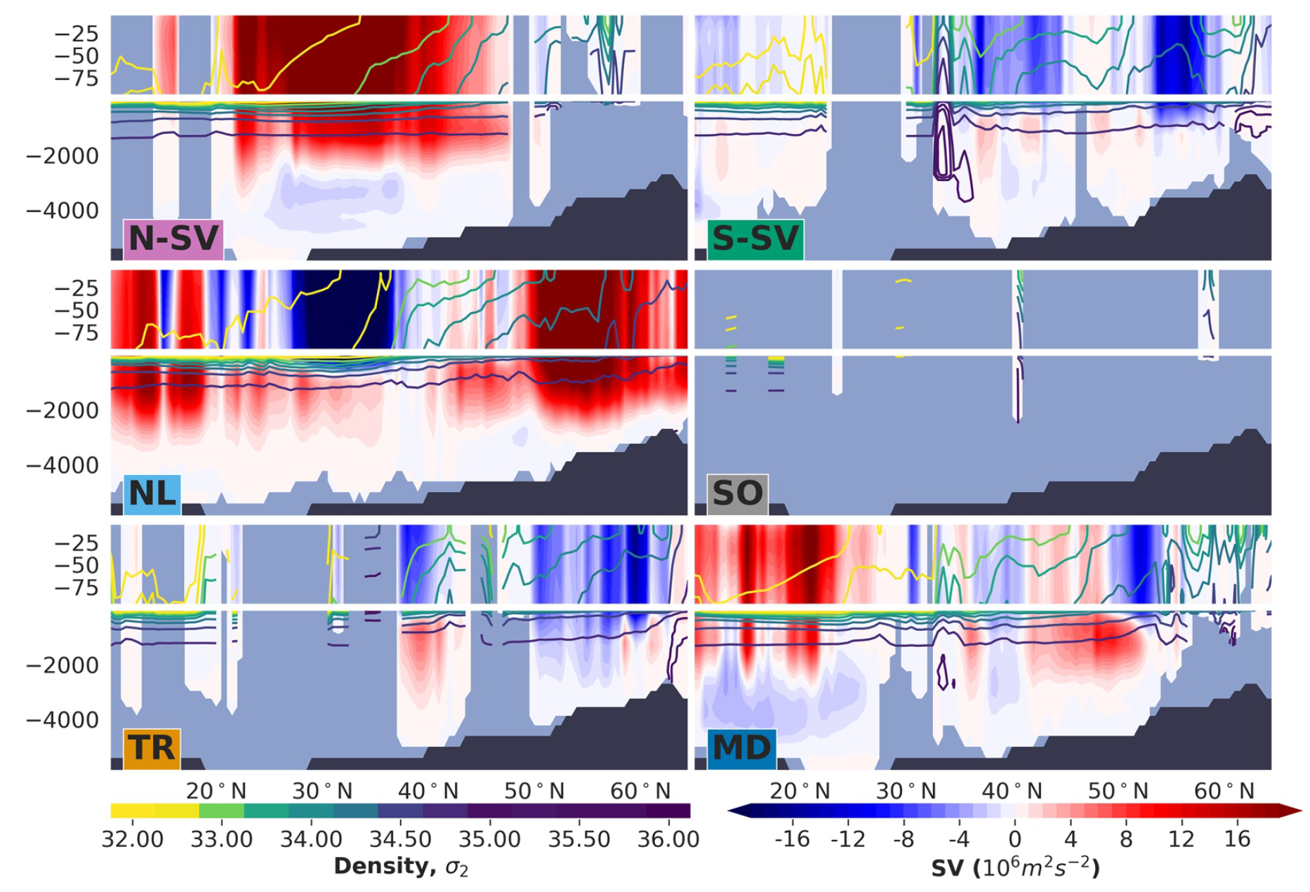
What is this dynamical regime’s vertical structure?

Slide 45
Which component(s) of the barotropic vorticity budget is most important to accurately predict that a given location is dominated by this regime?

Slide 46
Now let’s go back to the initial questions

Slide 47
